Slide 1
Business Performance Overview
Jewellery Sales & Profitability Analysis

Slide 2
BUSINESS OBJECTIVE
Analyze jewelry sales performance
Identify revenue & profit drivers
Understand customer and regional trends
Support data-driven business decisions

Slide 3
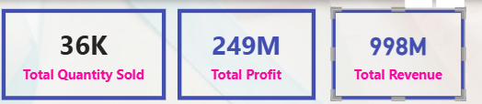
KPI Summary
Total Revenue
Total Profit
Total Quantity Sold

Slide 4
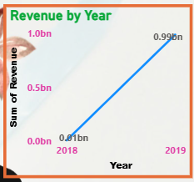
REVENUE TREND
Revenue growth trend over time
Seasonal or yearly demand patterns
Helps in forecasting future sales

Slide 5
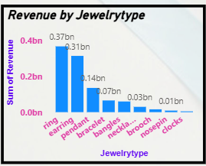
PRODUCT PERFORMANCE
Ring & Earring contributes the highest share of revenue
Pendant and other types support volume sales

Slide 6
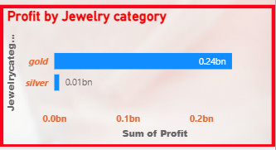
PROFITABILITY ANALYSIS
Certain categories deliver higher margins
Helps prioritize high-profit product

Slide 7
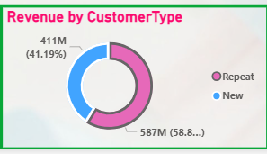
CUSTOMER ANALYSIS
Repeat customers generate higher revenue
Indicates strong customer retention value

Slide 8
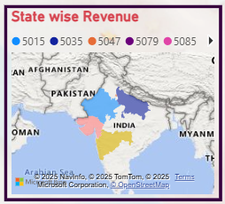
REGIONAL PERFORMANCE
Top-performing states identified
Regional focus can improve sales strategy

Slide 9
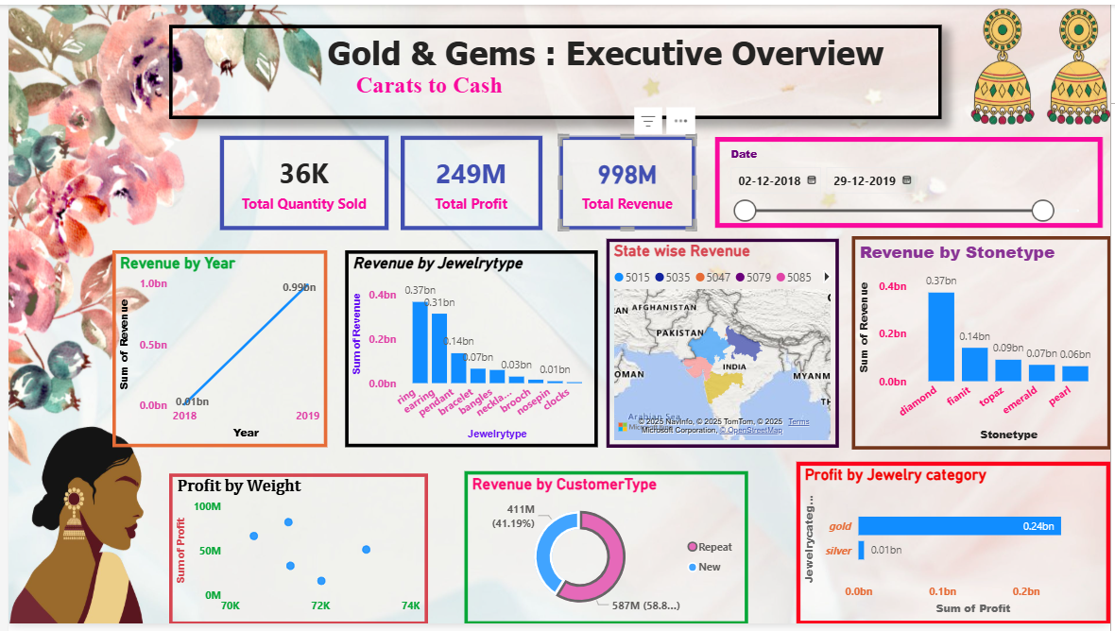
DASHBOARD FEATURES
Slicers for Date, State, Jewelry Type, Customer Type
Dynamic filtering for deeper analysis
User-friendly and business
focused design

